Slide 1

Part A Convolutional Neural Network (Fashion MNIST)
Name: Aw Shao yang
Student ID: p2012126
Class: DAAA/FT/2B/03

Slide 2
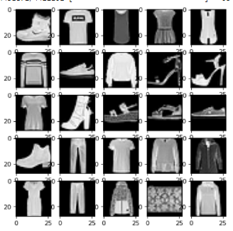
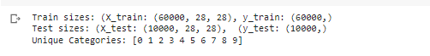
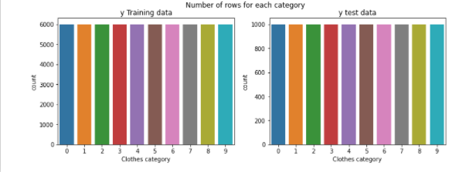
Through external research the classes of the images are classified as follows:
0: T-shirt/top
1: Trouser
2: Pullover
3: Dress
4: Coat
5: Sandal
6: Shirt
7: Sneaker
8: Bag
9: Ankle boot
Data Exploration
Through data exploration we see that:
We have 60000 images to train while our test set has 10000 images
There are 10 different categories of clothing
The images are black and white,
When building our model, we would need to consider these factors.
Since our model has 10 different categories, we set the final output layer to have only 10 nodes, 1 node for each category.
Images will have an input of 28 x 28 x 1 channel in the input layer for CNN
We see that the distribution for the labels are equal around all categories of clothing label. Each label has around 6000 training entries and 1000 testing entries.
This equal label distribution ensures that our prediction classes are not biased due to imbalanced classes

Slide 3
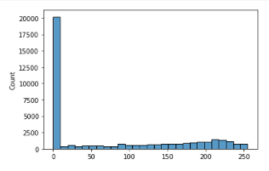

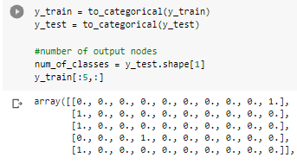
Data Exploration
Data Preparation
50 images pixel distribution
We do not need to flatten the input images to 1D since they are able to work using image data that are 2 Dimensional. But we need to reshape the dataset to NHWC before training it in our model, as well as normalize it
We see that the distribution of pixel values in the images are right skewed with most of the values concentrated at the value of 0 (black). This is likely due to all of the images having the same black background
From data exploration, we see that the output variable is an integer from 0 to 9. However, since this is a multi-class classification problem. As such, it is good practice to use a one hot encoding of the class values, transforming the vector of class integers into a binary matrix, for both normal and convolutional neural networks.

Slide 4
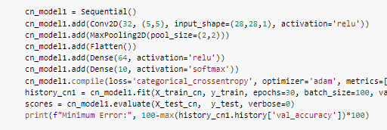
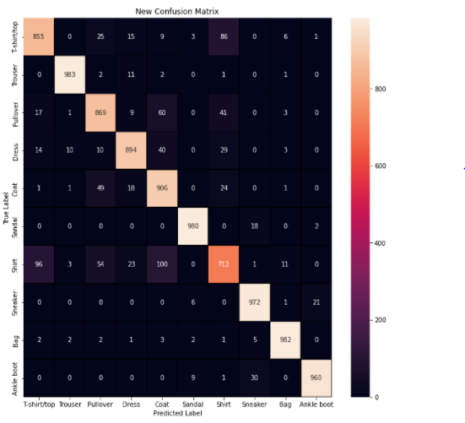
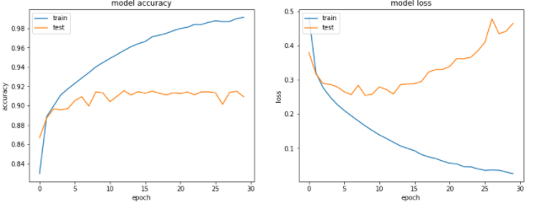

Neural Network Architecture (Baseline)
Model Performance
For the model, we see that we were able to obtain a validation accuracy score of up to 0.91. I got a score for an ANN and was only able to score up to 0.88 so this is quite a significant improvement. However, we see that the model overfits quite early and we have a huge increasing gap between the train and test scores. We also see the loss increasing as epochs go by.
This is the baseline CNN model’s architecture
Convolutional layer (32 filters, kernel size 5x5, ReLu)
Max Pooling layer (Pool size 2,2)
Flattening layer
Dense layer 64 Nodes (Activation function ReLu)
Output Layer 10 Nodes (Activation function SoftMax)
Loss categorical cross entropy, optimizer Adam(0.001)
Batch Size (100), Epochs (30)
Most errored class is shirt confused by coat and T-shirt/top likely due to similar shape and form
Best would be bag, likely due to it being unique in shape and figure

Slide 5
CNN Hyperparameter Tuning
These are the things that I have tried changing to improve my CNN model’s accuracy performance and reduce its model overfitting. (All attempts can be found in the .ipynb file )
(Successful) were the optimizations conducted that had successful improvements to the model at its predictions or overfitting.
(No changes) were the optimizations that worsened the model or did not change the model’s performance
Hyperparameter tuning was done in order of the list numbers (Left to Right)
Model Architecture Complexity
Hidden Layer Adjustment (No changes)
Hidden Layer Node Adjustment (Successful)
Conv2D and Max Pooling set Adjustment
2 Sets (Successful)
3 Sets (No changes)
Conv2D Stacking
2 Per Stack (Successful)
3 Per Stack (No changes)
Conv2D Inclusion of Padding (Successful)
Conv2D filter increase (Successful)
Inclusion of Batch Normalization (Successful)
Dropout Inclusion (Successful)
Layer Hyperparameters
9. Dropout Rate Adjustment (Successful)
10. Learning Rate and Optimizer (No changes)
11. Activation Function (No changes)
12. Batch Size (No changes)
13. Inclusion of Data Augmentation (will be discussed later)

Slide 6
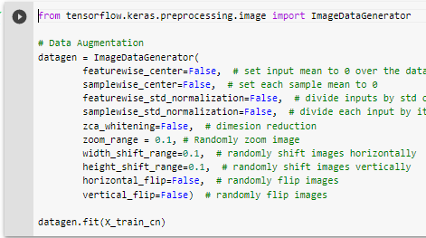
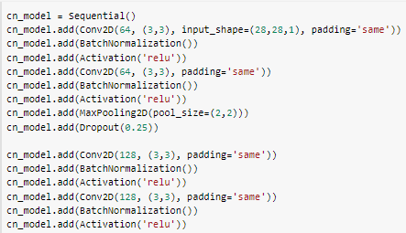
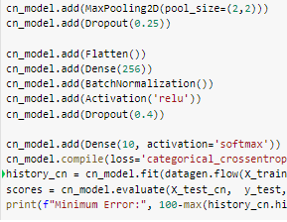
CNN with Data Augmentation
Here is where I applied data augmentation to my model fitting. This was meant to try an increase the validation accuracy of the model as well as reduce the model’s overfitting even further.
However, to create an appropriate model using data augmentation, I had to adjust some of the hyperparameters.
When I had trained using this data on my current model, I had found that even though yes it did help in reducing the overfitting, it also extended the number of epochs to obtain the best model.
Hence, I experimented and adjusted the dropout rates of my model to find the best combination for my model to lower the epochs, get the maximum possible accuracy and have the less overfitting
Feature Engineering
These are the image augmentations that I have applied
- Zoom image
- Shift image horizontally and vertically
Dropout Rates
MaxPool1 (0.25)
MaxPool2(0.25)
Dense (0.5)

Slide 7
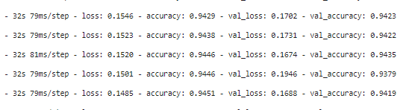
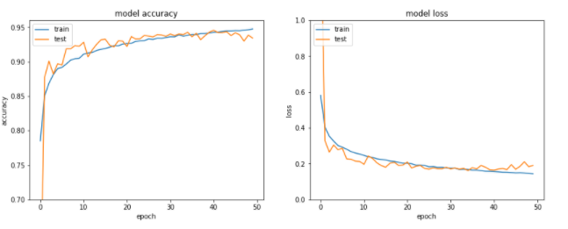
CNN with Data Augmentation model results
Through data augmentation and dropout rate adjustment for my model, we see that we were able to maintain the maximum accuracy score of 0.93 ~ 0.94 in the model’s classifications.
Not only that but looking at the epoch graphs, we managed to reduce the overfitting in the model to a good minimum by using data augmentation.
We have also been able to reduce the number of needed epochs to reach this score from >75 to around 43.
Looking at our results, this will be my best optimized model for the Fashion MNIST dataset,

Slide 8
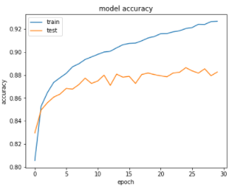
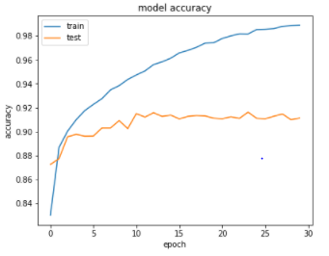
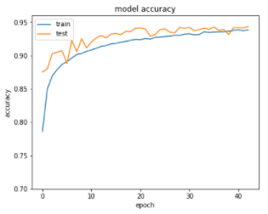
Final Model Evaluation
Metrics | Basic Model | CNN(Baseline) | CNN (Optimized With Data Augmentation)
Val Accuracy | 87% ~ 88% | 90% ~ 91.5% | 93% ~ 94%
Train Accuracy | 92% | 98% ~ 99% (Extreme overfitting) | 94% ~ 95%
Val Loss | 0.35 (Constant after awhile) | 0.46( Increasing after awhile) | 0.171
Loss | 0.2 | 0.03 | 0.170
Epochs Accuracy graphs
Overfitting
Extreme
Overfitting
No Overfitting

Slide 9
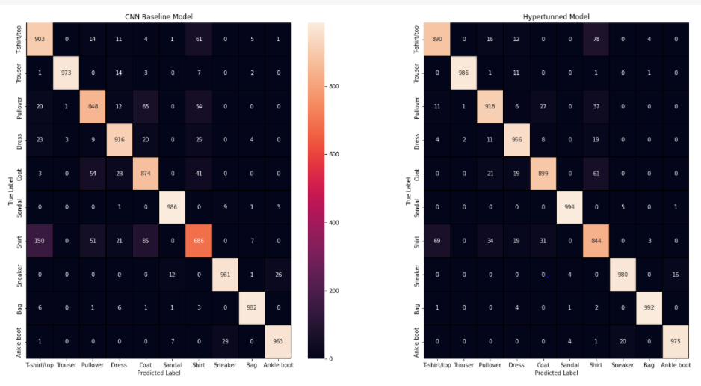
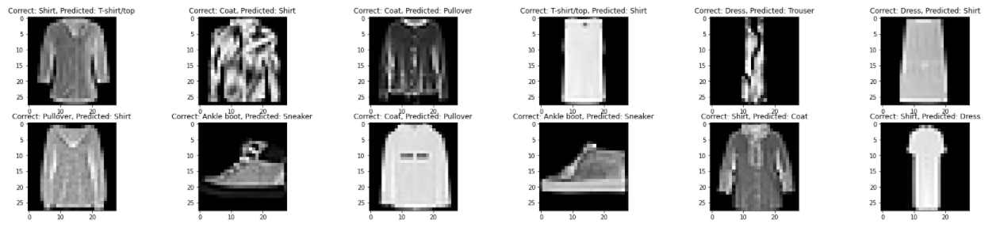
Model Performance Comparison
The accuracy gain was due to the significant improvement in Shirts.
Overall improvement in most of the categories but there are some slight deprovements in T-shirt/top and Trousers
We also see that we have managed to almost score perfectly in classifying certain items such as the bag category and sandals category.
The worst class for classification was still Shirt but it was still good improvement as compared to the baseline model and basic NN model
Reason for incorrect prediction of shirts, T shirts, Coat and pull overs seem to mainly be due to similar figure outlines and shapes.
Some were wrong due to items looking like they belong to another class.
Overall, the errors made by the model is likely due to the image itself being unclear of what the object actually is,. humans may have a challenge in guessing correctly on what they are.

